Slide 1
Introductory General Chemistry
Chemistry 3A
S. M. Halloran

Slide 2
Comparing Gases to Solids, Liquids
Pressure
Kinetic Molecular Theory as a Model for Gases
The Gas Laws of Boyle, Charles, Gay-Lussac, Avogadro
Ideal Gas Law and Applying It
Understanding Gas Mixtures

Slide 3
Comparing Solids/Liquids/Gases
H2O has same chemical properties whether as steam (water vapor), water, or ice, but physical properties differ
Covalent bonds affect molecular shape/geometry, bond energies, chemical properties
Intermolecular forces set the physical properties of liquids and solids
Kinetic molecular theory is used to explain properties of gases, but needs adjustments when gases become so dense they behave almost like liquids

Slide 4
Comparing Solids/Liquids/Gases
A substance’s state can be described as
Kinetic energy (moving around) of individual particles (molecules or atoms)
Temperature affects or indicates kinetic energy
The nature of intermolecular forces which are generally involved in attraction between molecules
Both temperature and pressure affect gases
Increasing pressure (which is a kind of density) also increases intermolecular forces

Slide 5
Properties of Gases, Liquids, Solids
Gases | Molecules widely separated Particle kinetic energy greater than intermolecular attractions Molecules fill container easily Non-ideal gas behavior occurs if attractive forces become significant
Liquids | Intermolecular attractive forces become significant such that liquid states form from gas states Liquids are not compressible and certainly denser than gases Liquids show a definite volume which does not depend on container size or shape Intermolecular attractive forces are not strong enough to fix position of molecules, so molecules and move around each other
Solids | Intermolecular attractive forces are such that molecules can be locked or fixed in position These solids like liquids are not compressible If the molecules forming the solid adopt an ordered packing arrangement, they can become crystalline

Slide 6

Pressure
Pressure is the physical property of a gas
$Pressure= \frac{Force}{Area}$
A TON of conversion factors for pressure
How many atmospheres in 595 torr?
$$595 torr ×\frac{1 atm}{760 torr}=0.783 atm$$
1 atmosphere (atm) [chemists] Expect to work with this in your calculations
= 760 millimeters of mercury (mm Hg) [meteorlogists]
= 760 torr (named after Italian scientist) [STEM people]
= 101,325 Pascal (Pa) [SI unit] = 101.325 kilopascals (kPa)
= 14.7 pounds per square inch (psi)
= 1.01325 bar

Slide 7

Problem Practice
1 atmosphere (atm) [chemists] Expect to work with this in your calculations
= 760 millimeters of mercury (mm Hg) [meteorlogists]
= 760 torr (named after Italian scientist) [STEM people]
= 101,325 Pascal (Pa) [SI unit] = 101.325 kilopascals (kPa)
= 14.7 pounds per square inch (psi)
= 1.01325 bar
How many atmospheres in 1,022 torr?
$$1022 torr ×\frac{1 atm}{760 torr}=1.345 atm$$
The atmosphere on Mars is largely CO₂ at a pressure of 6.01 mmHg. What is this pressure in atmospheres?
$$6.01 mm Hg ×\frac{1 atm}{760 mm Hg}=0.00791 atm=7.91 ×{10}^{−3} atm$$
Atmospheric pressure is low in the eye of a hurricane. In a 1979 hurricane in the Pacific Ocean, a pressure of 0.859 atm was reported inside the eye. What is this pressure in torr?
$$0.859 atm ×\frac{760 torr}{1 atm}=652 torr$$

Slide 8
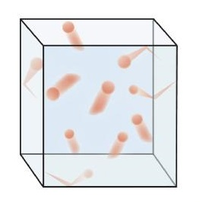
Kinetic Molecular Theory (KMT)
Also called “Kinetic [Molecular] Theory of Gases”
Principles/Assumptions
Gases are tiny particles in constant motion
Gases collide elastically with each other and walls of container. (In elastic collisions, no energy is lost)
Gas particles separated by large distances, relative to their own size
There can be no attractive or repulsive forces between the particles
Average speed dependent on temperature

Slide 9
Gas Laws
In the 15th to 17th centuries scientists did experiments with gases in which they discovered properties they could reliably reproduce
From the results, gas laws were described that developed the mathematics to explain behavior of the gases
These laws are described next

Slide 10
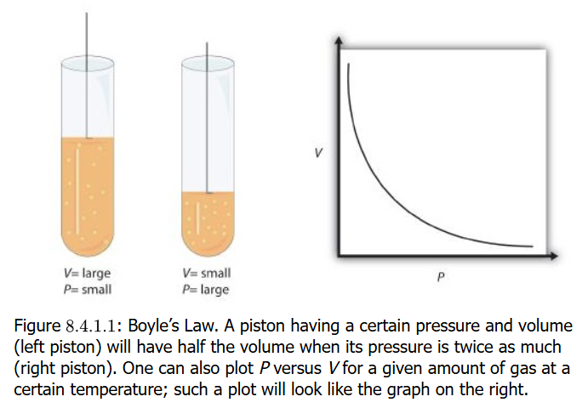
Boyle’s Law (PV=k)
1662: Boyle noted that if a gas is kept at constant temperature, that if the volume of the is increased, the pressure of the gas decreases
He also noted if the volume of the gas is decreased again at constant temperature, the pressure is increased
The mathematical description of this observation is the hyperbola plot shown in the figure. This shows that volume (V) times pressure (P) is a constant (k)

Slide 11
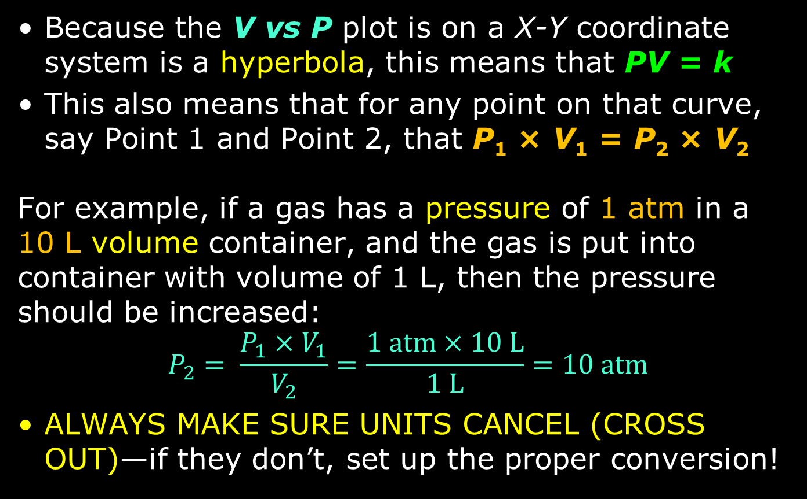
Boyle’s Law (PV=k)
Because the V vs P plot is on a X-Y coordinate system is a hyperbola, this means that PV = k
This also means that for any point on that curve, say Point 1 and Point 2, that P₁ × V₁ = P₂ × V₂
For example, if a gas has a pressure of 1 atm in a 10 L volume container, and the gas is put into container with volume of 1 L, then the pressure should be increased:
$$P_{2}= \frac{P_{1}×V_{1}}{V_{2}}=\frac{1 atm×10 L}{1 L}=10 atm$$
ALWAYS MAKE SURE UNITS CANCEL (CROSS OUT)—if they don’t, set up the proper conversion!

Slide 12
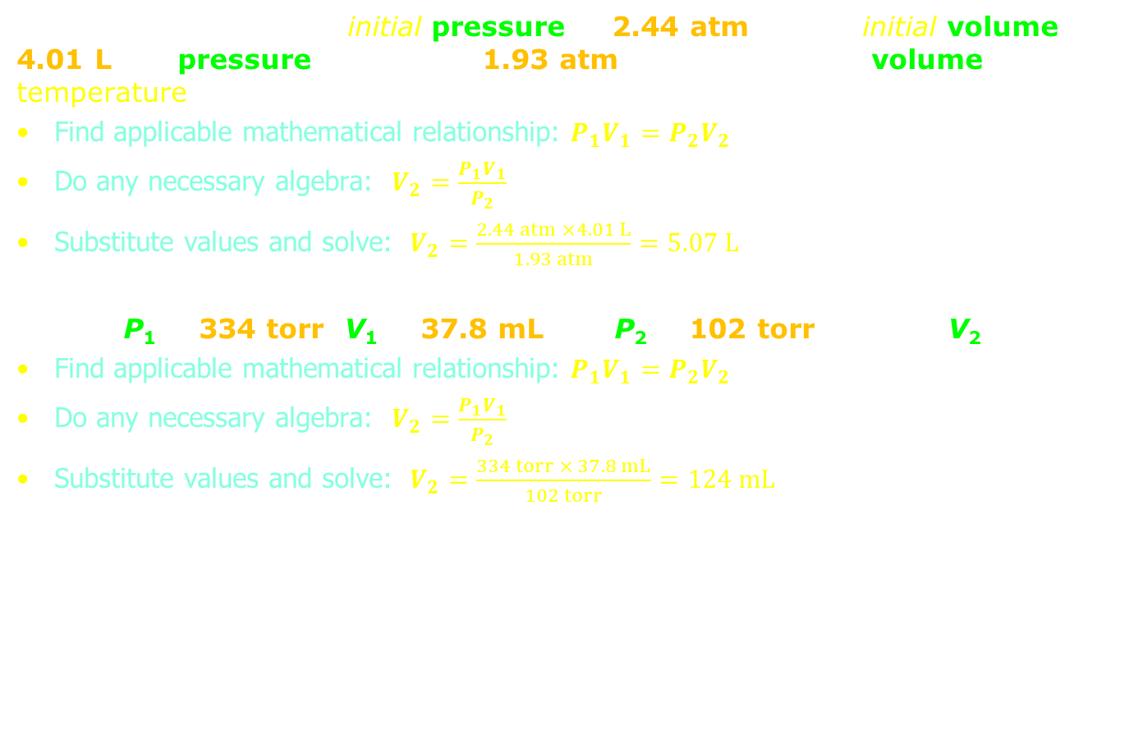
Problem Practice
A sample of gas has an initial pressure of 2.44 atm and an initial volume of 4.01 L. Its pressure changes to 1.93 atm. What is the new volume if temperature?
Find applicable mathematical relationship: $P_{1}V_{1}=P_{2}V_{2}$
Do any necessary algebra: $V_{2}=\frac{P_{1}V_{1}}{P_{2}}$
Substitute values and solve: $V_{2}=\frac{2.44 atm ×4.01 L}{1.93 atm}=5.07 L$
Solve: P₁ = 334 torr, V₁ = 37.8 mL and P₂ = 102 torr. What is V₂?
Find applicable mathematical relationship: $P_{1}V_{1}=P_{2}V_{2}$
Do any necessary algebra: $V_{2}=\frac{P_{1}V_{1}}{P_{2}}$
Substitute values and solve: $V_{2}=\frac{334 torr × 37.8 mL}{102 torr}=124 mL$

Slide 13
Problem Practice
A sample of gas has an initial pressure of 722 torr and an initial volume of 88.8 mL. Its volume changes to 0.663 L. What is the new pressure?
Find applicable mathematical relationship: $P_{1}V_{1}=P_{2}V_{2}$
Do any necessary algebra: $P_{2}=\frac{P_{1}V_{1}}{V_{2}}$
Substitute values: $P_{2}=\frac{722 atm × 88.8 mL}{0.663 L}$
If units don’t cancel (cross out), do conversions!:
$P_{2}=\frac{722 torr × \left(88.8 mL × \frac{1 L}{1000 mL}\right)}{0.663 L}$ OR $P_{2}=\frac{722 torr × 88.8 mL}{0.663 L × \frac{1000 mL}{1 L}}$
Result time: $P_{2}=96.7 torr$
Solve: P₁ = 308 torr, V₁ = 456 mL and P₂ = 1.55 atm. What is V₂?
Find applicable mathematical relationship: $P_{1}V_{1}=P_{2}V_{2}$
Do any necessary algebra: $V_{2}=\frac{P_{1}V_{1}}{P_{2}}$
Substitute values: $V_{2}=\frac{308 torr × 456 mL}{1.55 atm}$
If units don’t cancel (cross out), do conversions!:
$V_{2}=\frac{\left(308 torr × \frac{1 atm}{760 torr}\right) × 456 mL}{1.55 atm}$ OR $V_{2}=\frac{308 torr × 456 mL}{1.55 atm × \frac{760 torr}{1 atm}}$
Result time: $V_{2}=119 mL$
Find applicable mathematical relationship: $P_{1}V_{1}=P_{2}V_{2}$
Do any necessary algebra: $V_{2}=\frac{P_{1}V_{1}}{P_{2}}$
Substitute values and solve: $V_{2}=\frac{2.44 atm ×4.01 L}{1.93 atm}=5.07 L$
Solve: P₁ = 334 torr, V₁ = 37.8 mL and P₂ = 102 torr. What is V₂?
Find applicable mathematical relationship: $P_{1}V_{1}=P_{2}V_{2}$
Do any necessary algebra: $V_{2}=\frac{P_{1}V_{1}}{P_{2}}$
Substitute values and solve: $V_{2}=\frac{334 torr × 37.8 mL}{102 torr}=124 mL$

Slide 14
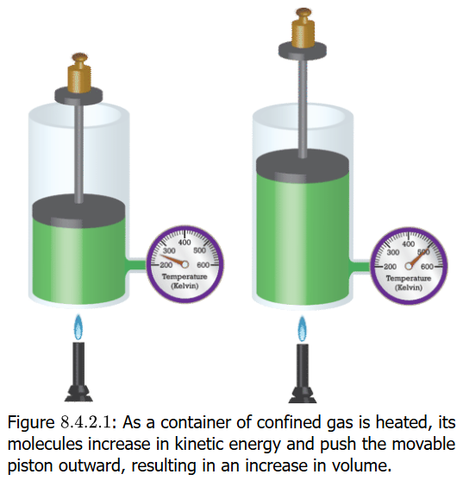
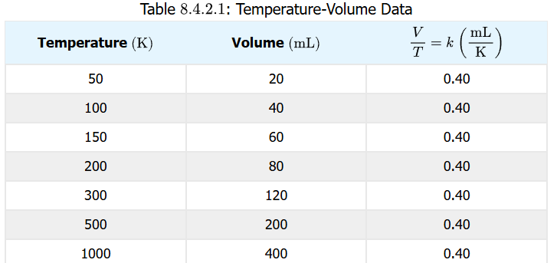
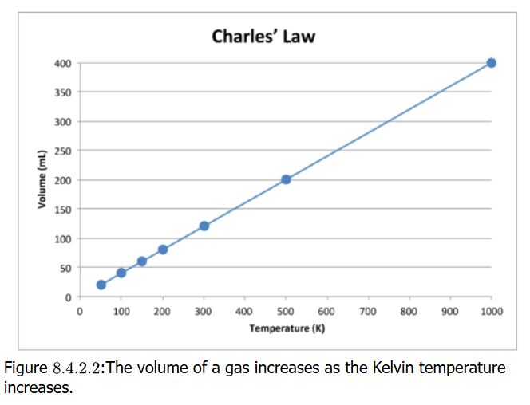

Charle’s Law (V=kT)
As a gas is heated (temperature (T) is monitored) with important part of keeping the pressure constant
In the process, the gas increases in volume (V) in a linearly constant way (k)
Temperate must be measured on the Kelvin scale for mathematical relation to work
$$V=kT → \frac{V}{T}=k$$
$$→ \frac{V_{1}}{T_{1}}=\frac{V_{2}}{T_{2}}$$

Slide 15
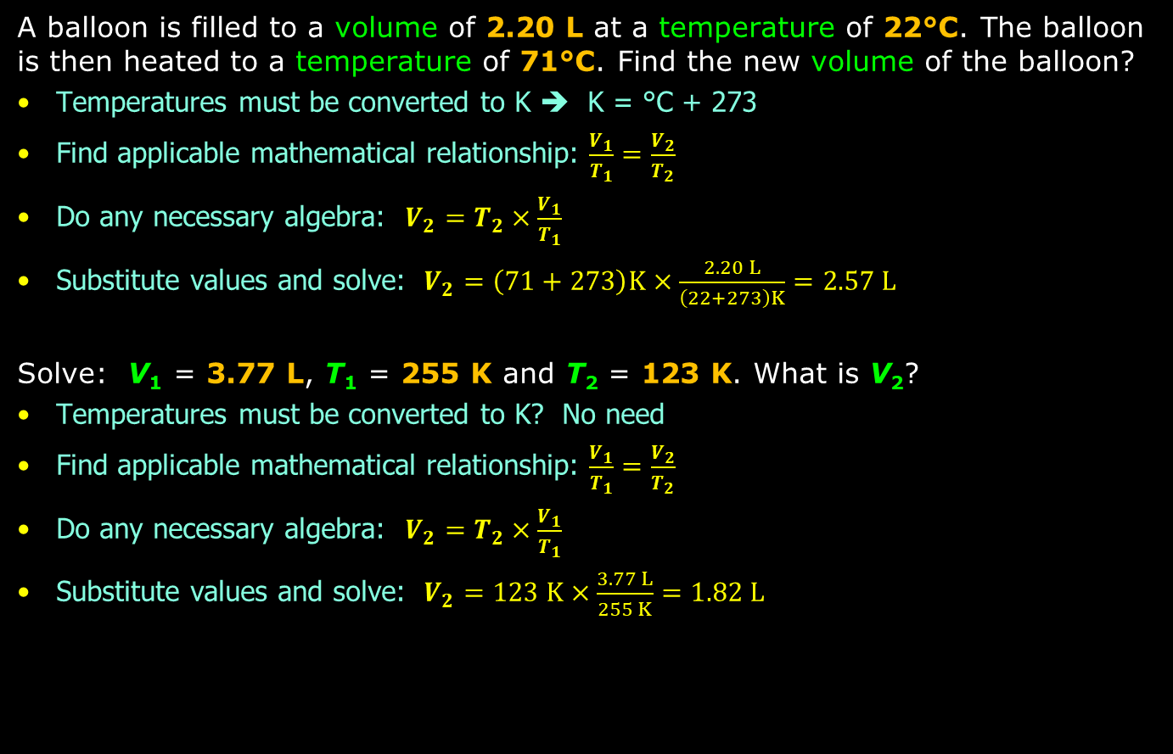
Problem Practice
A balloon is filled to a volume of 2.20 L at a temperature of 22°C. The balloon is then heated to a temperature of 71°C. Find the new volume of the balloon?
Temperatures must be converted to K ➔ K = °C + 273
Find applicable mathematical relationship: $\frac{V_{1}}{T_{1}}=\frac{V_{2}}{T_{2}}$
Do any necessary algebra: $V_{2}=T_{2}×\frac{V_{1}}{T_{1}}$
Substitute values and solve: $V_{2}=\left(71+273\right)K×\frac{2.20 L}{\left(22+273\right)K}=2.57 L$
Solve: V₁ = 3.77 L, T₁ = 255 K and T₂ = 123 K. What is V₂?
Temperatures must be converted to K? No need
Find applicable mathematical relationship: $\frac{V_{1}}{T_{1}}=\frac{V_{2}}{T_{2}}$
Do any necessary algebra: $V_{2}=T_{2}×\frac{V_{1}}{T_{1}}$
Substitute values and solve: $V_{2}=123 K×\frac{3.77 L}{255 K}=1.82 L$

Slide 16
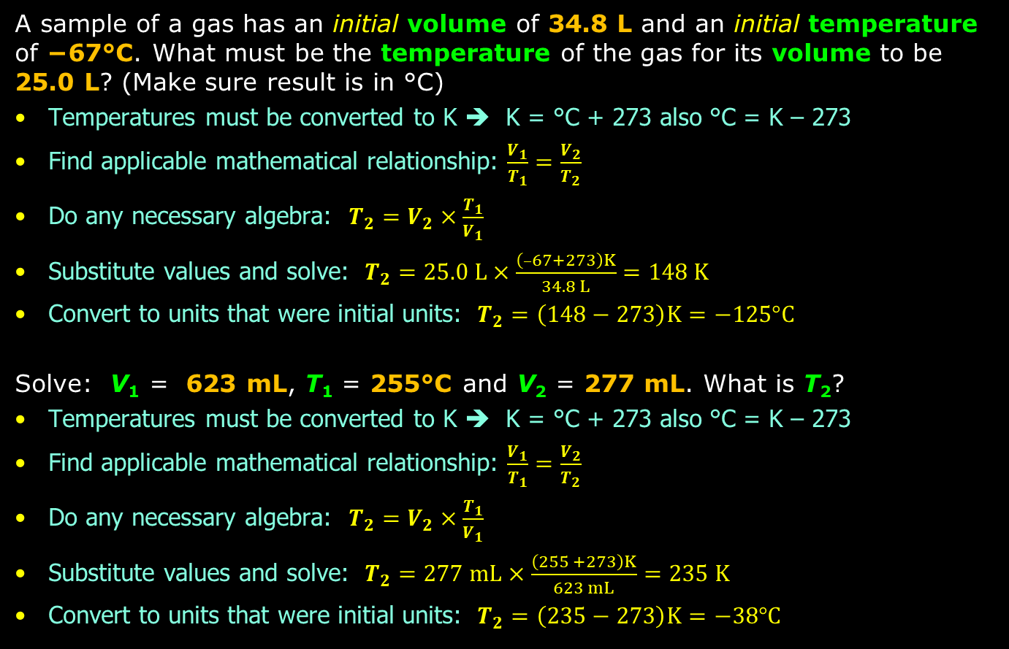
Problem Practice
A sample of a gas has an initial volume of 34.8 L and an initial temperature of −67°C. What must be the temperature of the gas for its volume to be 25.0 L? (Make sure result is in °C)
Temperatures must be converted to K ➔ K = °C + 273 also °C = K – 273
Find applicable mathematical relationship: $\frac{V_{1}}{T_{1}}=\frac{V_{2}}{T_{2}}$
Do any necessary algebra: $T_{2}=V_{2}×\frac{T_{1}}{V_{1}}$
Substitute values and solve: $T_{2}=25.0 L×\frac{\left(–67+273\right)K}{34.8 L}=148 K$
Convert to units that were initial units: $T_{2}=\left(148−273\right)K=−125°C$
Solve: V₁ = 623 mL, T₁ = 255°C and V₂ = 277 mL. What is T₂?
Temperatures must be converted to K ➔ K = °C + 273 also °C = K – 273
Find applicable mathematical relationship: $\frac{V_{1}}{T_{1}}=\frac{V_{2}}{T_{2}}$
Do any necessary algebra: $T_{2}=V_{2}×\frac{T_{1}}{V_{1}}$
Substitute values and solve: $T_{2}=277 mL×\frac{\left(255 +273\right)K}{623 mL}=235 K$
Convert to units that were initial units: $T_{2}=\left(235−273\right)K=−38°C$

Slide 17
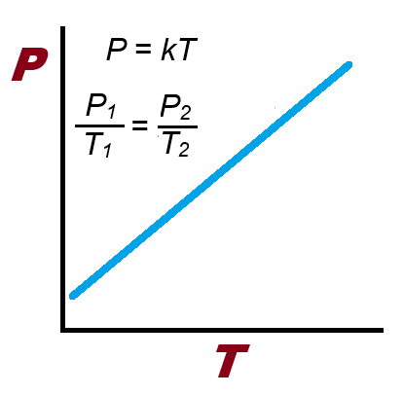
Gay-Lussac’s Law (P₁/T₁=P₂/T₂)
This particular gas law brings in temperature as a factor in how gases behave
The law states very simply that as the temperature of a gas in a container is increased, the pressure of the gas is increased in a linearly constant way as well
The P vs T plot should be a straight line with positive slope (k > 0)

Slide 18
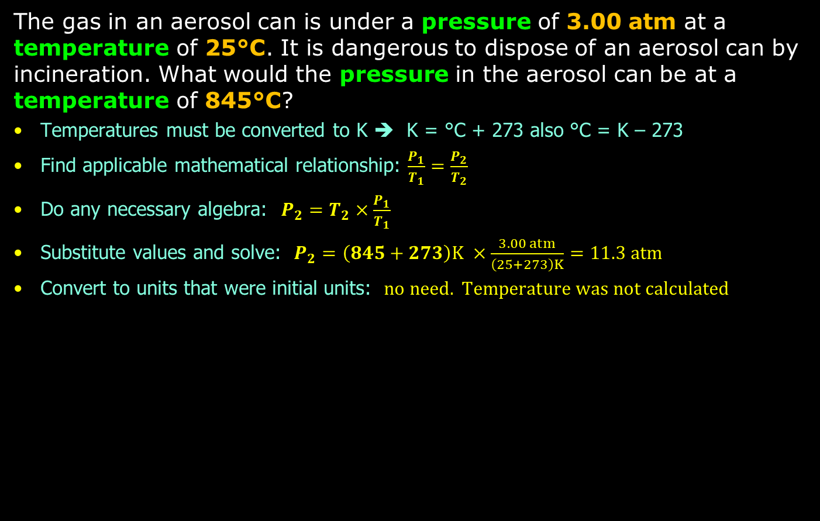
Problem Practice
The gas in an aerosol can is under a pressure of 3.00 atm at a temperature of 25°C. It is dangerous to dispose of an aerosol can by incineration. What would the pressure in the aerosol can be at a temperature of 845°C?
Temperatures must be converted to K ➔ K = °C + 273 also °C = K – 273
Find applicable mathematical relationship: $\frac{P_{1}}{T_{1}}=\frac{P_{2}}{T_{2}}$
Do any necessary algebra: $P_{2}=T_{2}×\frac{P_{1}}{T_{1}}$
Substitute values and solve: $P_{2}=\left(845+273\right)K ×\frac{3.00 atm}{\left(25+273\right)K}=11.3 atm$
Convert to units that were initial units: $no need. Temperature was not calculated$

Slide 19
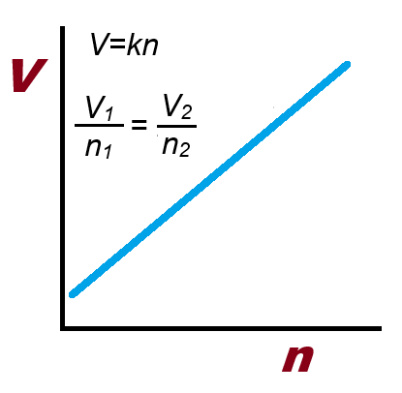
Avogadro’s Law (V=k × n)
Avogadro studied amounts of atoms and molecules. The number of atoms and molecules totaling 6.022 × 10²³ amounting to 1 mole is attributed to Avogadro
Avogadro stated: “Equal volumes of all gases, at the same temperature and pressure, contain the same number of molecules”
Just like the P=kT gas law, the V=kn gas law is a straight line with positive slope (k > 0)

Slide 20
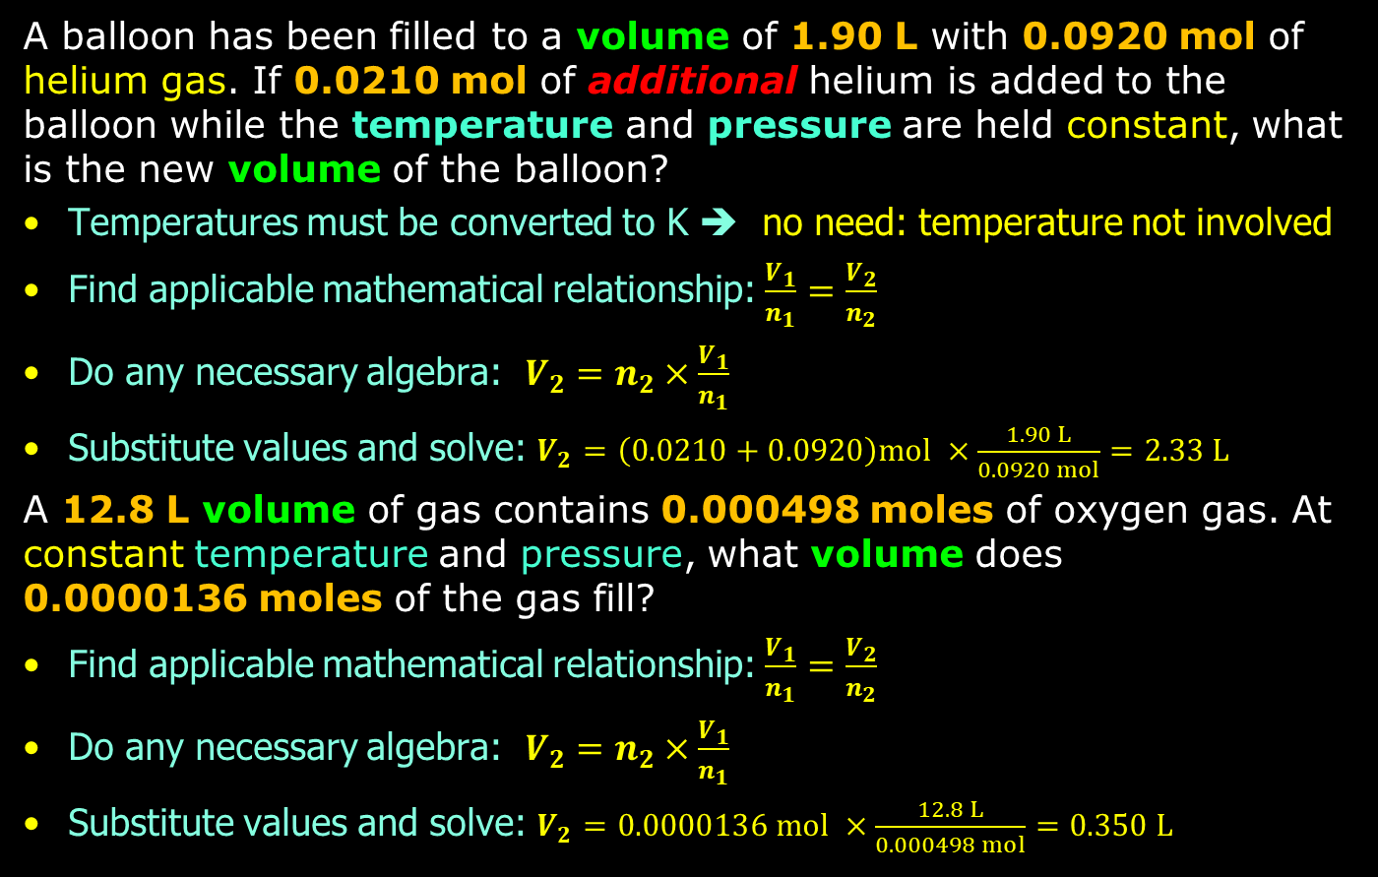
Problem Practice
A balloon has been filled to a volume of 1.90 L with 0.0920 mol of helium gas. If 0.0210 mol of additional helium is added to the balloon while the temperature and pressure are held constant, what is the new volume of the balloon?
Temperatures must be converted to K ➔ no need: temperature not involved
Find applicable mathematical relationship: $\frac{V_{1}}{n_{1}}=\frac{V_{2}}{n_{2}}$
Do any necessary algebra: $V_{2}=n_{2}×\frac{V_{1}}{n_{1}}$
Substitute values and solve: $V_{2}=\left(0.0210+0.0920\right)mol ×\frac{1.90 L}{0.0920 mol}=2.33 L$
A 12.8 L volume of gas contains 0.000498 moles of oxygen gas. At constant temperature and pressure, what volume does 0.0000136 moles of the gas fill?
Find applicable mathematical relationship: $\frac{V_{1}}{n_{1}}=\frac{V_{2}}{n_{2}}$
Do any necessary algebra: $V_{2}=n_{2}×\frac{V_{1}}{n_{1}}$
Substitute values and solve: $V_{2}=0.0000136 mol ×\frac{12.8 L}{0.000498 mol}=0.350 L$

Slide 21
Ideal Gas Law (PV = nRT)

Slide 22
Dalton’s Partial Pressures Law

